Slide 1

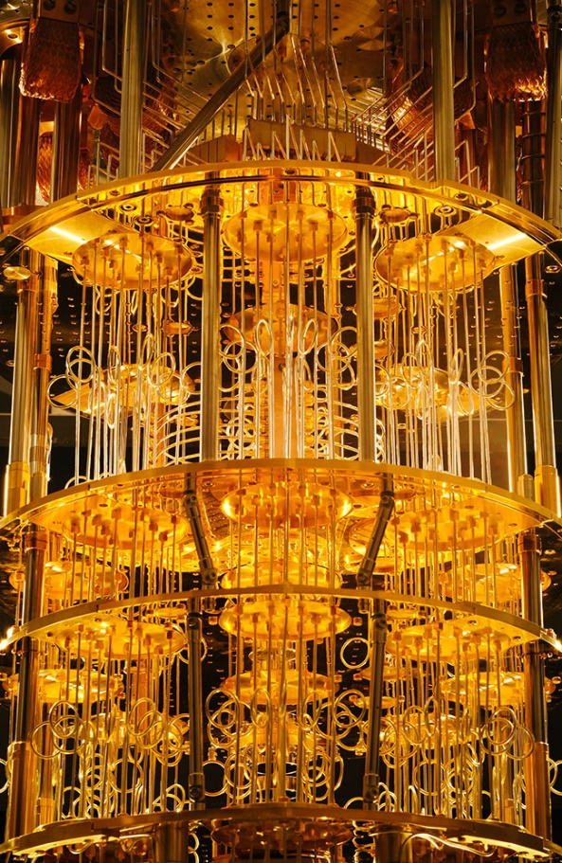
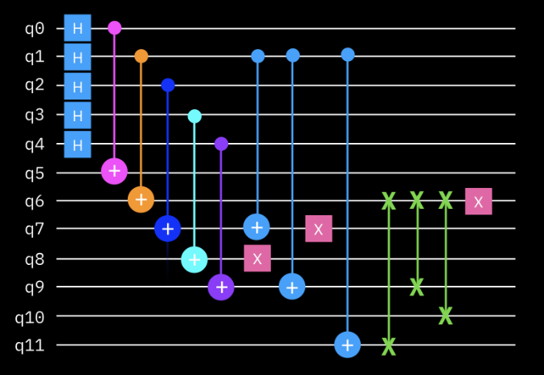
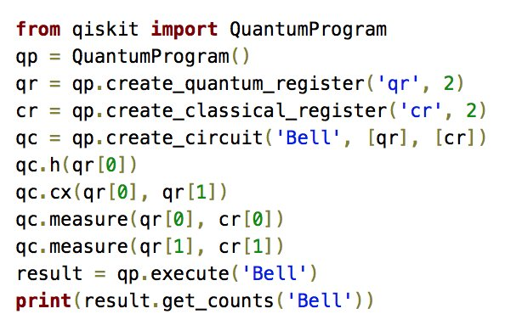
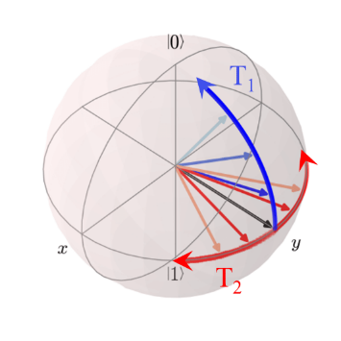

Foundations of
Quantum Information Science (QIS 101)
Dave Biersach
Brookhaven National Laboratory
dbiersach@bnl.gov
Session 03
Introducing
Python

Slide 2
Session 03 – Goals
Review the rules for declaring identifiers
Understand statements and scopes
Declare variables and use built-in data types
Display the values of variables in the output terminal
Create simple loops with the for statement
Introduce range() as a "lazy" list definition
Import modules to call existing functions
Review mathematical operators in Python

Slide 3
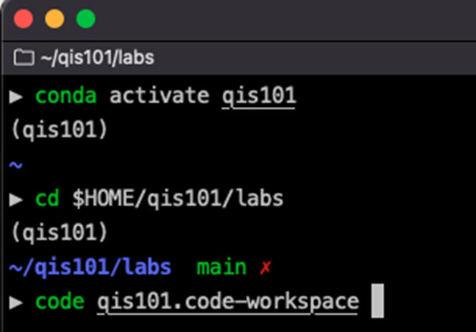
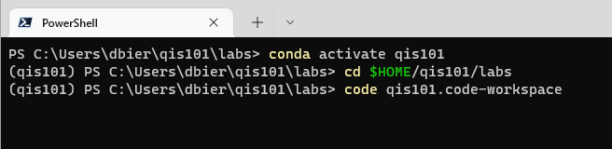
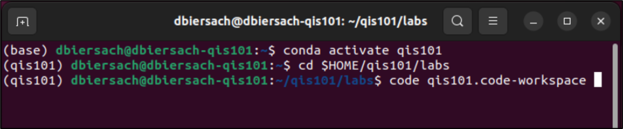
Starting Visual Studio Code
Open a terminal session, activate the QIS101 virtual environment, and launch VS Code:
conda activate qis101
cd $HOME/qis101/labs
code qis101.code-workspace

Slide 4
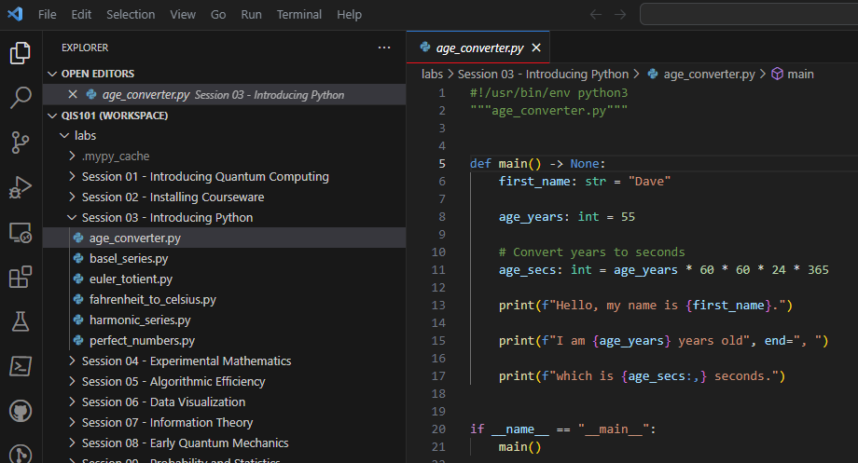
Open age_converter.py

Slide 5
Identifiers
Identifiers are just names – everything in code has a name
Names must be < 64 chars in length
They can include upper- or lower-case letters & numbers
Identifiers must start with a letter and cannot contain spaces!
Three types of identifier “casing”
CamelCaseEachWord
camelCaseEachWord
all lower_case with underscores
Identifiers in Python are case sensitive!!
x is not the same as X
Use ALLCAPS to define global constants (very rare)
(first letter is Capitalized)
(first letter is not capitalized)
(Snake case in Python!)
✓

Slide 6
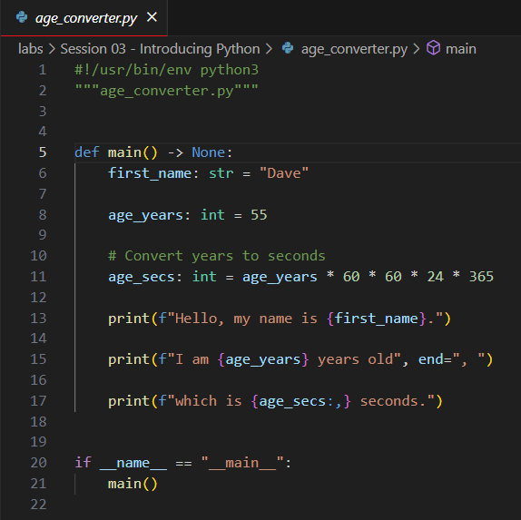
Identifiers
Variable
Name
Source code comments start with a #
Function
Name
An f string
A formatter

Slide 7
Variable Types
Variables store data in memory to be used later
Variables can be called whatever you want
Pick variable names that mean something to a human
Use snake_case (all lower case, underscores to break words)
Python supports many built-in data types for variables:
int = Stores integers only
float = Stores real numbers with 15 digits of precision
bool = Stores True or False (Boolean logic)
str = Stores zero or more letters & numbers
Python mostly “infers” the type of a variable

Slide 8
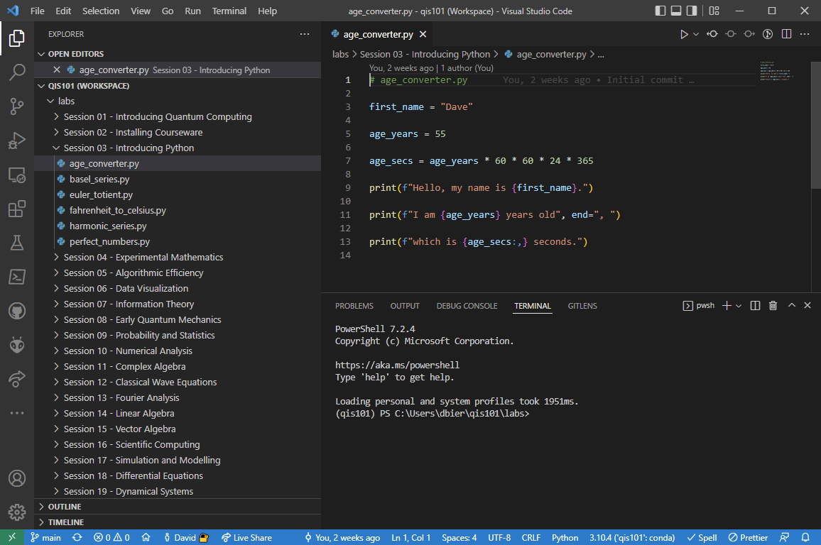
Run age_converter.py
Ensure the qis101 environment is active

Slide 9
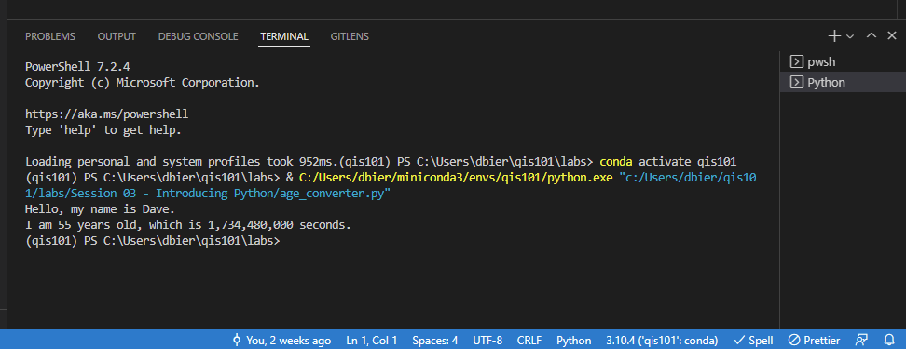
Edit age_converter.py
Edit the code to display your name and age in seconds

Slide 10
Temperature Conversion
Your scientists needs a program to calculate the correct Celsius temperature for a given Fahrenheit temperature
Display values between -44°F and 216°F inclusive
Your code should increment the temperature in steps of 4°F
Make the output look nice: display both the Fahrenheit and Celsius temperatures in right justified columns, with two digits to the right of the decimal in each column
The research problem your scientist wants you to solve:
What is the one temperate that is the same
in both Fahrenheit and Celsius?

Slide 11
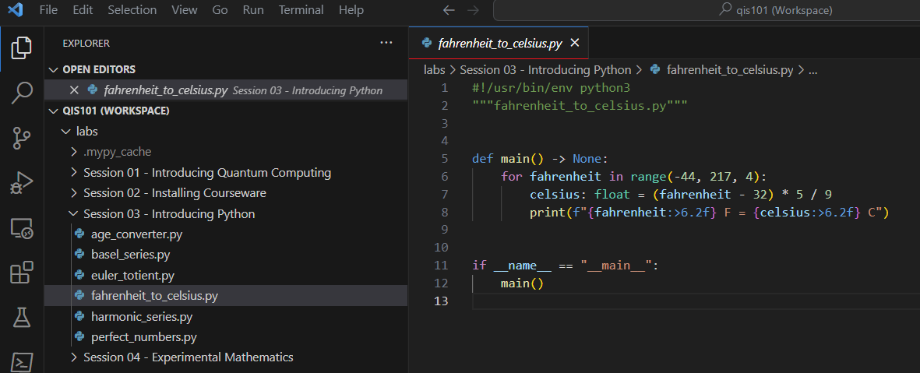
Open fahrenheit_to_celsius.py

Slide 12
Statements & Scopes
A statement does something (think: sentence)
A statement is either a declaration, a keyword, or a function
Statements are executed from top to bottom of a scope
A scope contains one or more statements (think: paragraph)
A scope in Python begins with a colon :
Scopes are also denoted via indentation
All the statements in a scope must start at the same column
Scopes can be nested – each inner scope is further indented
Certain Python statements "introduce" (require) a new scope
In Python, white space is significant – indentation matters!

Slide 13
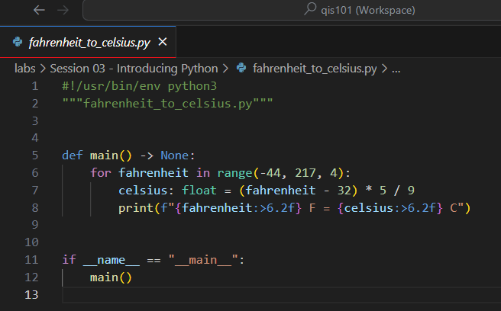
Statements and Scopes
The statements in a for loop scope are all indented by the same amount
A for loop introduces a scope with a colon :
Identifiers live only within the scope in which they are defined
(except for globals & closures)

Slide 14


for loops
A for loop executes all the statements within its scope for each item in the list passed into the for
It is common to use the range() function to describe the list of numbers passed into the for statement
The range() function takes three parameters: (start, stop, step)
The stop value is required but the start and step values are optional
The default value for start is 0 and for step is 1
The range is inclusive, exclusive: [start, stop)
$$⟹$$

Slide 15
Displaying Variables
The print() function is used to display the value of variables
When running inside Visual Studio Code, the print() output will show up in the Python console window at the bottom of screen
String literals must be enclosed in quotation marks (single or double)
Python can substitute a variable's value into a placeholder
To make a placeholder (aka replacement field) you enclose the variable name between curly braces {}
Substituting a variable's actual value into its replacement field is called string interpolation
Placeholders can also contain format specifiers
You can specify number of digits to the right of the decimal, etc.
You can specify left/right/center justification, column width, etc.

Slide 16

print() and f-strings
Placing a lowercase f before the first quote in a print() statement indicates you will use some placeholders
A placeholder contains the variable's name sandwiched between curly braces {}
A colon after the variable's name starts a format specifier

Slide 17
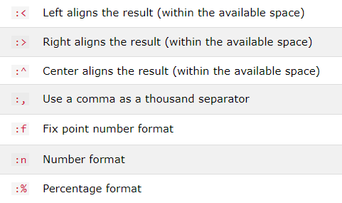
Some Common Format Specifiers
Using format specifiers is optional but makes your output more professional

Slide 18
print() and f-strings
Print the current value of the variable fahrenheit right-justified (>) in a column six characters wide (6) and round to two digits (.2f) to the right of the decimal

Slide 19
Mathematical Operators
Python operators obey normal PEMDAS precedence
Expressions are evaluated left to right in your source code
Use = to assign a value to a variable
Use * for multiplication and / for division operators
Use parenthesis to explicit specify the order of operations
The “greater than or equal to” operator is >=
The “less than or equal to” operator is <=

Slide 20
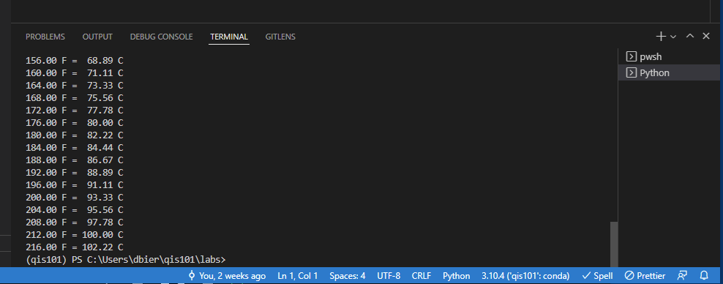
Run fahrenheit_to_celsius.py
Scroll the output window UP
What is the one temperate that is the same
in both Fahrenheit and Celsius?

Slide 21
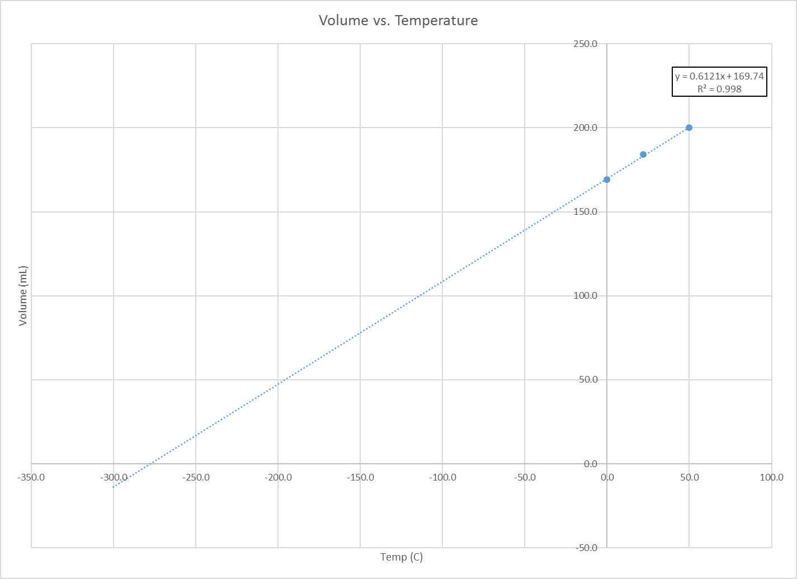
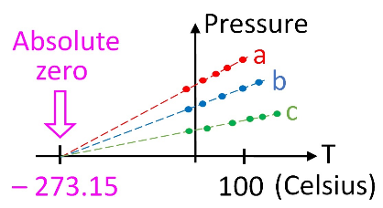
How did we calculate absolute zero in 1779? (PV = nRT)

Slide 22
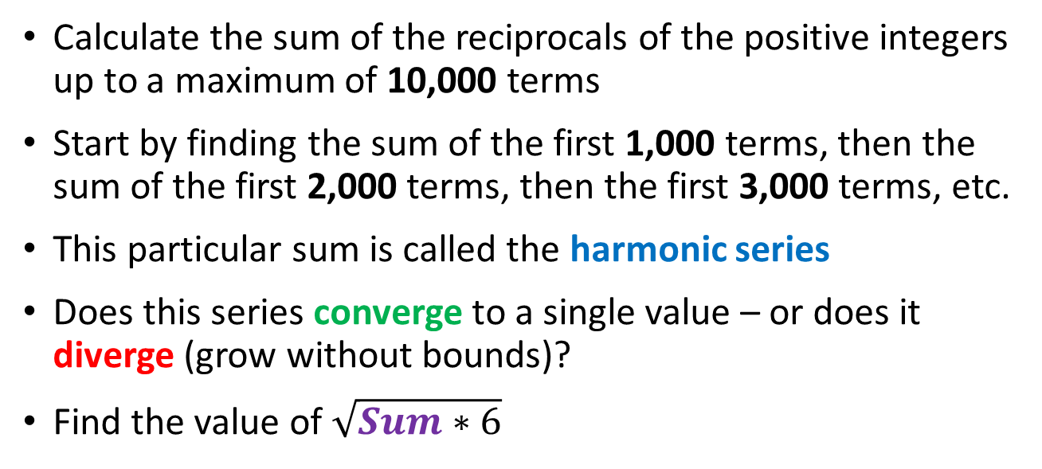
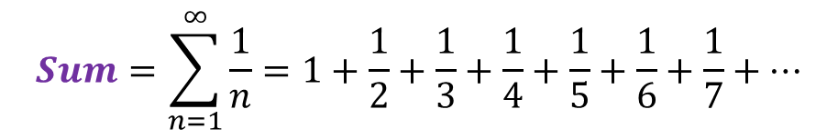
The Harmonic Series
$$Sum=\sum_{n=1}^{∞}{\frac{1}{n}=1+\frac{1}{2}+\frac{1}{3}+\frac{1}{4}+\frac{1}{5}+\frac{1}{6}+\frac{1}{7}+…}$$
Calculate the sum of the reciprocals of the positive integers up to a maximum of 10,000 terms
Start by finding the sum of the first 1,000 terms, then the sum of the first 2,000 terms, then the first 3,000 terms, etc.
This particular sum is called the harmonic series
Does this series converge to a single value – or does it diverge (grow without bounds)?
Find the value of $\sqrt{Sum∗6}$

Slide 23
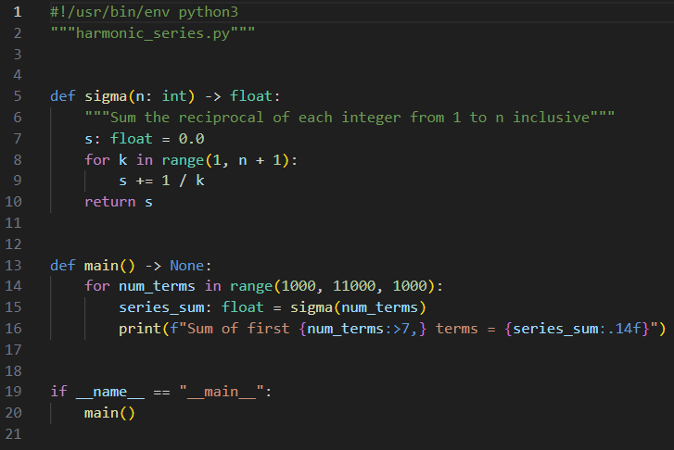
Open harmonic_series.py
The #! is a "shebang" that allows us to run a Python script directly from the command line (terminal/shell)
Triple quotes wrap a "docstring"
https://realpython.com/documenting-python-code
https://peps.python.org/pep-0257

Slide 24
View harmonic_series.py
This if statement tells the Python interpreter what function to call when this script is run (versus being imported by another script)

Slide 25
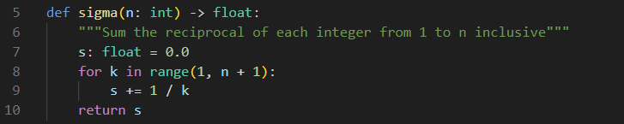
Defining a function
def is how we define a function
The function name
The inbound parameters
The return type
Functions can return a value

Slide 26
Defining a function
Be mindful a colon starts a scope
Statements within a scope are indented

Slide 27
View harmonic_series.py
③
④
⑤
⑥
⑦
①
②
⑧

Slide 28
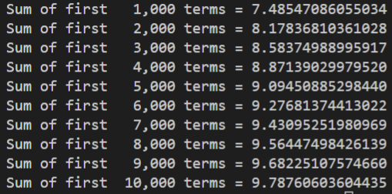
Run harmonic_series.py
We cannot prove the convergence/divergence of the harmonic series using only code

Slide 29
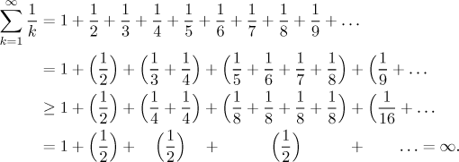
The Harmonic Series Diverges

Slide 30
The Harmonic Series Diverges

Slide 31
The Harmonic Series Diverges

Slide 32
The Harmonic Series Diverges

Slide 33
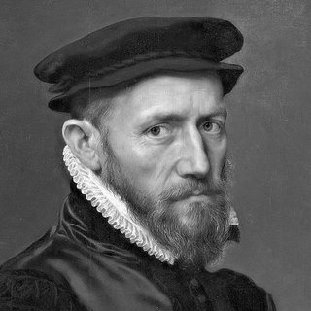
The Harmonic Series Diverges
The harmonic series diverges
Nicole Oresme (c. 1360)

Slide 34
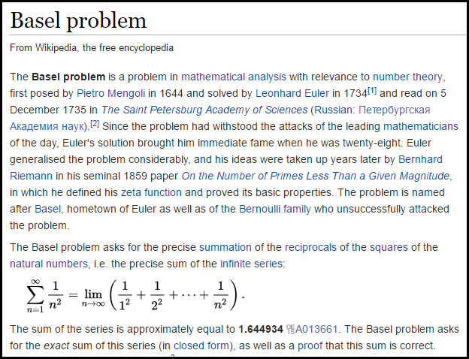

Slide 35
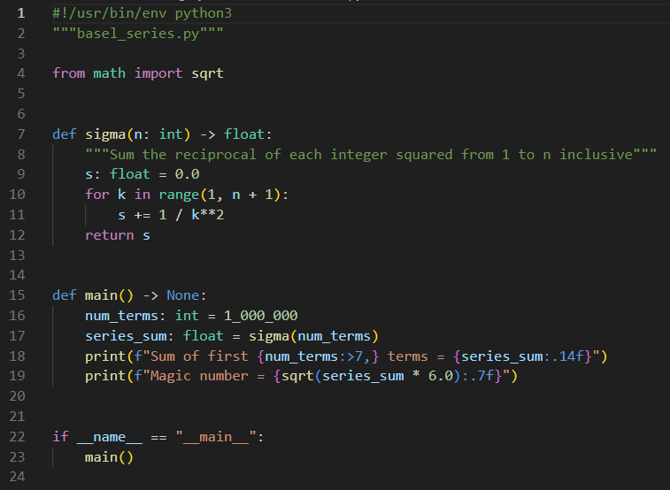
Open basel_series.py
This tells the Python interpreter to import a module that contains functions we can then call in our code

Slide 36
View basel_series.py
④
⑤
①
②
③
⑥
⑦

Slide 37
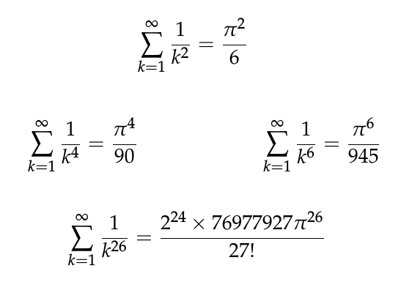
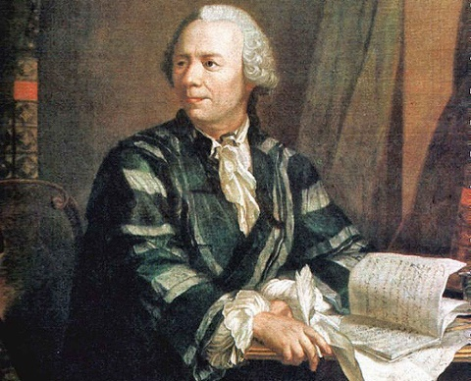
Run basel_series.py
The series converges
Leonhard Euler
(1707 – 1783)

Slide 38
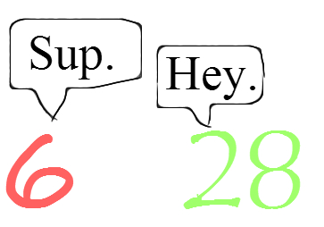
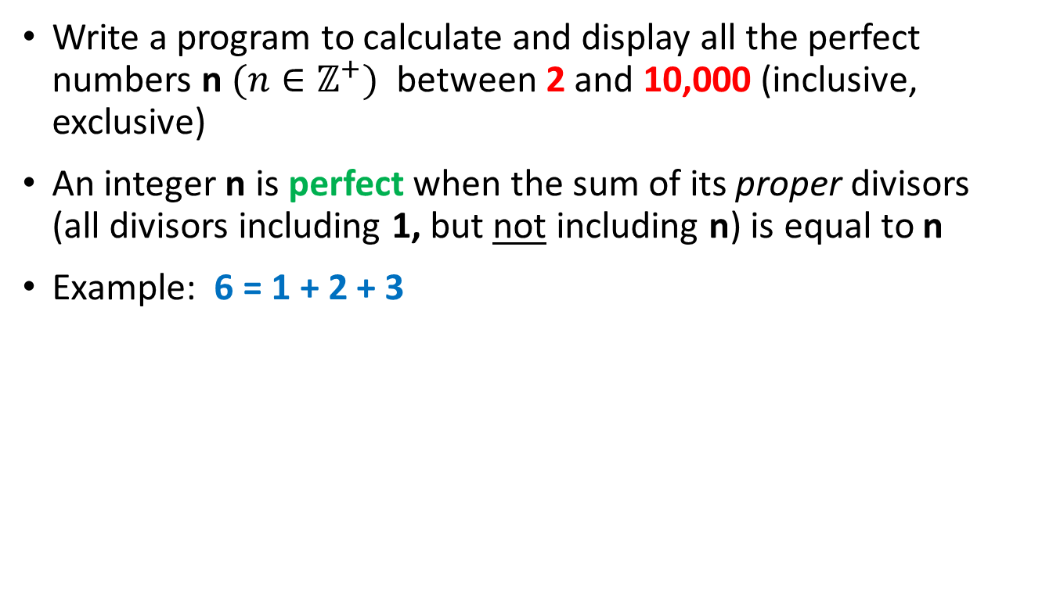
Perfect Numbers
Write a program to calculate and display all the perfect numbers n $(n∈ℤ^{+})$ between 2 and 10,000 (inclusive, exclusive)
An integer n is perfect when the sum of its proper divisors (all divisors including 1, but not including n) is equal to n
Example: 6 = 1 + 2 + 3

Slide 39
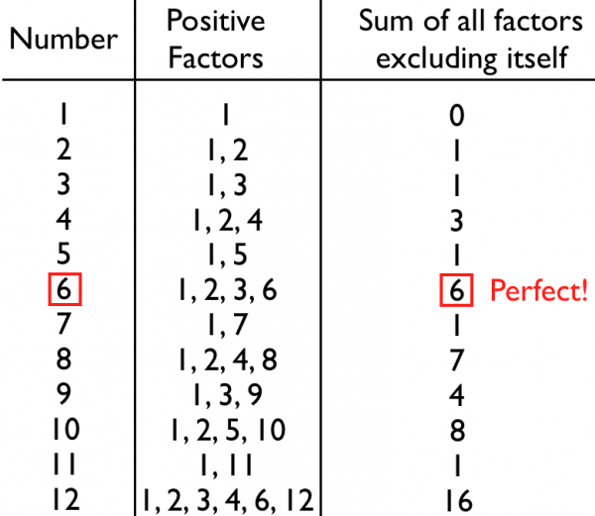
Perfect Numbers

Slide 40
if Statement
An if statement identifies which code block (scope) to run based upon the value of a Boolean expression
The expression (the condition) must evaluate to either a True or a False value
If the condition is True, then the scope immediately following the if statement is executed
If the condition is False, and there is an else clause, then the scope immediately following the else statement is executed
Every if statement does not need to have an else clause
You can also use elif to continue to test for other conditions
The if, elif, and else statements all introduce scopes (meaning they require a colon at the end of their line)

Slide 41
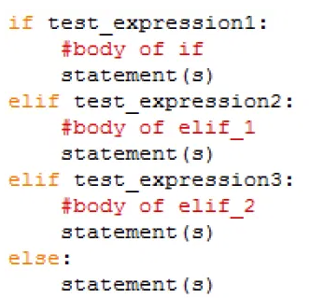
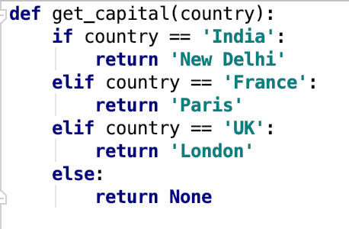
if Statement
def is how we define a function
Functions can return values
Be mindful of the colons : that start the scopes

Slide 42
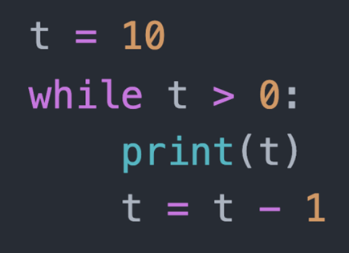
while Loop
A while loop executes all the statements within its scope as long as the loop conditional remains True
The loop conditional
A while loop introduces a scope

Slide 43
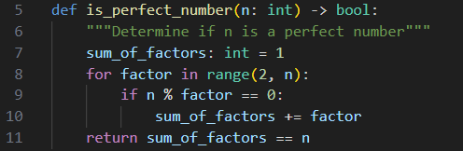
The Modulus (%) Operator
The “mod” operator (%) returns the integer remainder of an implicit division operation, e.g., 37 % 5 = 2
Use double equals operator (==) when testing for equality

Slide 44
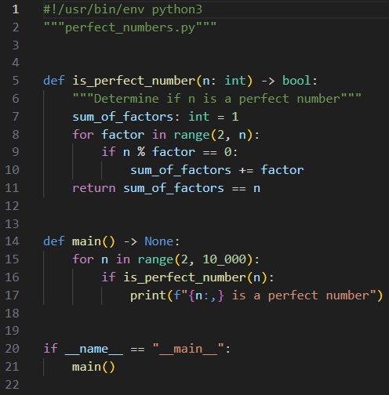
Open perfect_numbers.py
④
⑤
⑥
⑦
⑧
⑨
①
②
③
⑩

Slide 45
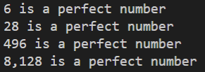
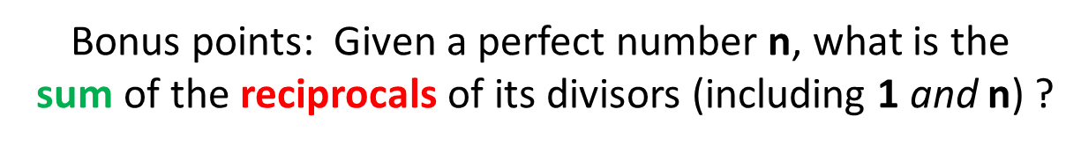
Run perfect_numbers.py
Do you notice anything special about these numbers?

Slide 46
Perfect Numbers
Euclid–Euler theorem
$$\left\{p,\left(2^{p}−1\right) \right\}∈primes→2^{\left(p−1\right)}\left(2^{p}−1\right) is perfect$$
Note: This formula might not be the only one to generate perfect numbers – we still don't know for sure!

Slide 47
Euler’s Totient
Calculate Euler’s Totient for all integers between 2 and 100 inclusive
The totient of an integer is the “number of positive integers” less than the given integer that are relatively prime to that integer
Totient(12) = 4 because only {1, 5, 7, 11} are relatively prime to 12
http://www.wolframalpha.com/input/?i=totient(12)
Your program should display only those integers whose value exceeds its own totient value by 1 exactly
What do you notice about those integers?

Slide 48
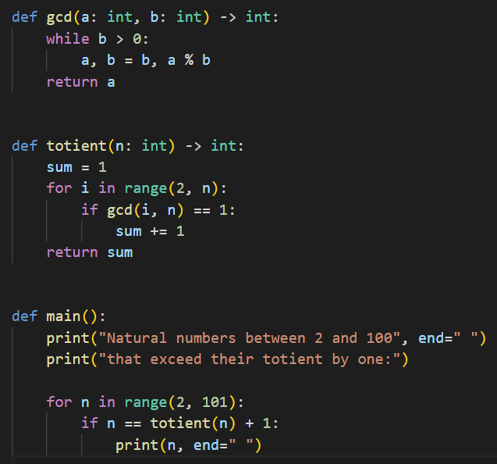
Open euler_totient.py
⑦
⑧
Tuple Packing & Unpacking
Typing hints are optional but helpful
④
⑤
⑥
⑨
①
②
③
⑩

Slide 49
Run euler_totient.py
What do you notice about those integers that exceed their totient value by 1?

Slide 50
Python vs Java/C++
Python is a dynamically typed language
It is not necessary to declare the type of a variable before assigning a value to it, and a variable can change its type within a scope
In Python, a variable doesn't hold anything – a variable name is just a label for a static value
Function names are normally followed by parenthesis ()
Both functions and statements can introduce scopes using a colon :
Python is whitespace sensitive!
A scope is not enclosed in curly braces {} like in Java/C++
Horizontal indentation is how you denote scopes in Python
All statements sharing the same scope must be vertically aligned

Slide 51
Python vs Java/C++
Python is an interpreted language, not normally compiled
The reference implement of Python is CPython, which is a Python interpreter written in C
Python does not use a classical static linker – you can easily call external code residing in external modules/packages on-the-fly
Python code is inherently more functional (declarative) than procedural (imperative) like Java/C++
With procedural languages you must tell the computer step-by-step how exactly to accomplish what you want
With functional languages you tell the computer what you want to accomplish, and it determines the best way to satisfy your request

Slide 52
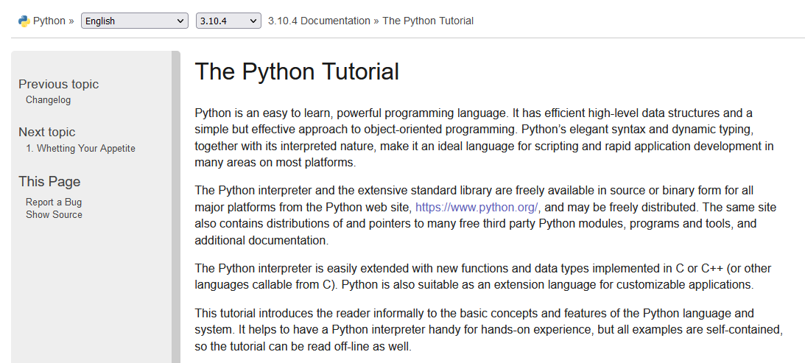
The Python Tutorial
https://docs.python.org/3/tutorial

Slide 53
Session 03 – Now You Know…
How to define variables in Python (snake_case)
How to use print() to show variable values on screen
How to use f-strings with {} placeholders (replacement fields) for variable names
How to indicate format specifiers in order to make your code output more human readable and professional looking
How to define an iterable sequence using range()
How to pass the lazy list generated by range() into the for statement to enumerate each value in that sequence
Python uses the "inclusive/exclusive" paradigm constantly

Slide 54
Session 03 – Now You Know…
How to place comments in your code using #
How to use special system-defined "double underscore" (aka dunder) methods to support running Python code directly from the command line
Using single underscore character for thousands separator in numeric literals
How to declare custom functions using def
How to import modules (external packages / libraries / functions) using the import statement
How to use tuple unpacking to do multiple variable assignments with a single line of code

Slide 55
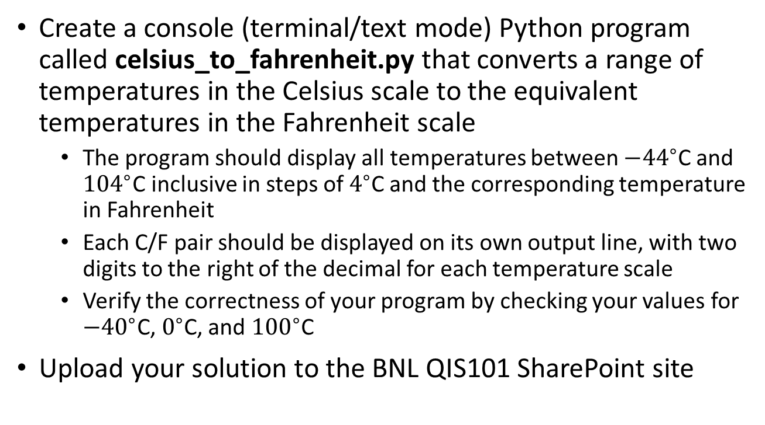
TASK 03-01
Create a console (terminal/text mode) Python program called celsius_to_fahrenheit.py that converts a range of temperatures in the Celsius scale to the equivalent temperatures in the Fahrenheit scale
The program should display all temperatures between ${−44}^{∘}$C and ${104}^{∘}$C inclusive in steps of $4^{∘}$C and the corresponding temperature in Fahrenheit
Each C/F pair should be displayed on its own output line, with two digits to the right of the decimal for each temperature scale
Verify the correctness of your program by checking your values for ${−40}^{∘}$C, $0^{∘}$C, and ${100}^{∘}$C
Upload your solution to the BNL QIS101 SharePoint site

Slide 56
TASK 03-02
Create a program sum_squares.py to sum the first 1,000 natural numbers squared
Verify the loop sum by also displaying the value calculated using the functional equation for Gaussian summation
Format the output of the two sums using a comma as the thousand's separator
Upload your solution to the BNL QIS101 SharePoint site

Slide 57
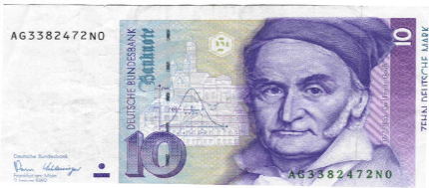

A Shortcut
Carl Friedrich Gauss
(1777 – 1855)
Sum the integers from 1 to 10
1
2
3
4
5
6
7
8
9
10
1 | 9
2 | 8
3 | 7
4 | 6
5
10
n = 10
4 matched rows that each sum to 10
1 row that is = 10 / 2 = 5
1 row that is = n = 10
$$=\frac{n∗(n+1)}{2}$$
= 55

Slide 58


Another Shortcut
Sum of first n
natural numbers:
Sum of squares of first n natural numbers:
n | n^2 | Sum
1 | 1 | 1
2 | 4 | 5
3 | 9 | 14
4 | 16 | 30
5 | 25 | 55
6 | 36 | 91
7 | 49 | 140
8 | 64 | 204
9 | 81 | 285
10 | 100 | 385
These are functional equations -
we can now calculate the sums
immediately without having to loop over every element!

Slide 59
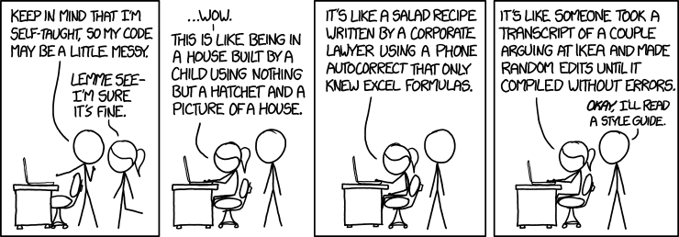
TASK 03-03
Create a program sum_multiples.py to display the sum of all natural numbers less than 1900 that are divisible by both 7 and 11
Upload your solution to the BNL QIS101 SharePoint site

